Slide 1
Health-Tracker using Python
Mitch Abrams
Dan Hausamann
Billy Hector
ISE 314

Slide 2
Agenda
Introduction
Objective
Our Program
Conclusions
Ideas for Future Research

Slide 3
Introduction
Trends towards healthy lifestyles
People need a way to know what is right for them
Everyone’s needs are different
Wanted a program to help users help themselves

Slide 4
Objective
Our goal was to create a program to track the user’s health
Users should be able to input physical data
Outputs will help users maintain healthy lifestyle

Slide 5
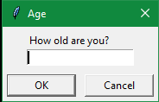
User Inputs
Age
Name
Age
Weight
Height
Gender
Goals
How old are you?
OK
Cancel

Slide 6
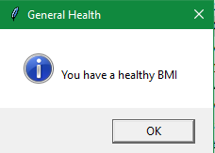
Outputs
General Health
BMI
Suggested Calories
Surgeon General Suggestions
You have a healthy BMI
OK

Slide 7
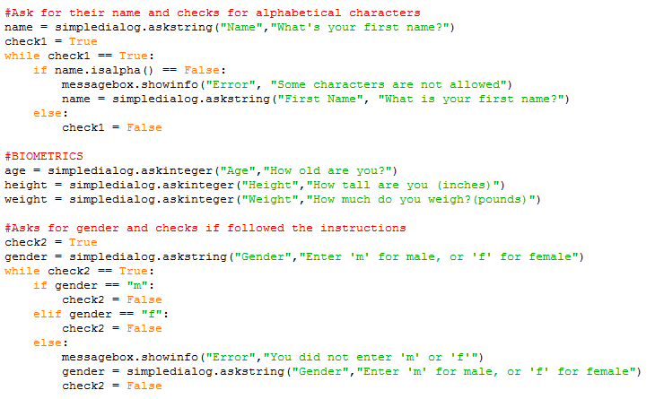
Code (Inputs)

Slide 8
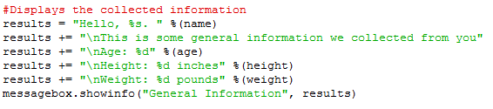
Code (Input Summary)

Slide 9
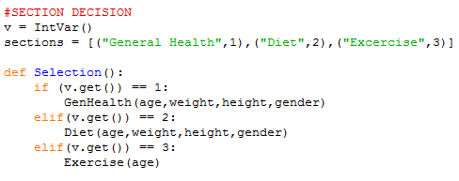
Code (Menu)

Slide 10
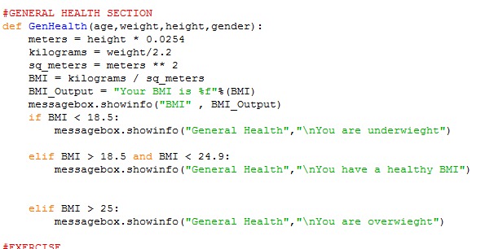
Code (General Health)

Slide 11
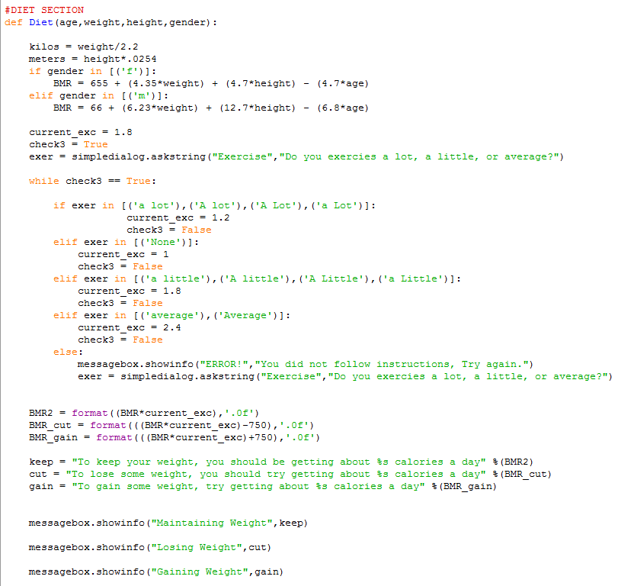
Code (Diet)

Slide 12
Code (Diet)

Slide 13
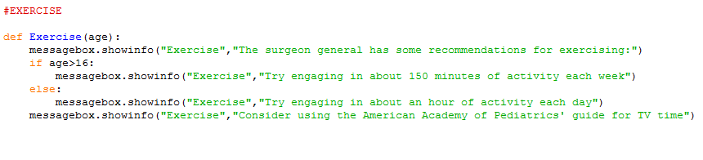
Code (Exercise)

Slide 14
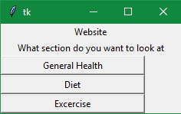
Tkinter
tk
Standard GUI package
Our uses:
Dialog Boxes
Radio Buttons
Message Boxes
Website
What section do you want to look at?
General Health
Diet
Exercise

Slide 15
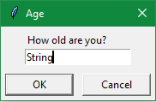
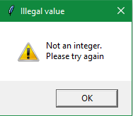
Checks
System in place to ensure users are inputting correct data type
Stops process from continuing until data is accessible

Slide 16
Conclusions
People want an easy way to track health
Program gives an easy interface to help out
Use of GUIs and checks to aid process

Slide 17
Ideas for Future Research
Personally catered exercise tips
Nutrient suggestions based on user goals
Ability to use open ended questions

